Slide 1
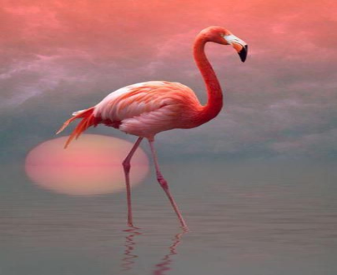
PROJECT TITLE- Catch The Flamingo
Guided by- Submitted by-
Mr. Nitin Kumar Paras (1502913059)
Akansha Jain (1502913007)
Pooja Agarwal (1502931102)
Presentation No. : 5 Group No. : G5
DEPARTMENT OF INFORMATION TECHNOLOGY
KIET GROUP OF INSTITUTIONS, GHAZIABAD, UTTAR PRADESH
(AFFILIATED TO DR. A.P.J. ABDUL KALAM TECHNICAL UNIVERSITY, LUCKNOW, UTTAR PRADESH)

Slide 2
Objectives
Demonstrating the implemented tools.
Communicating the insights generated from them.

Slide 3
Problem Statement
Data file Description
ad-clicks.csv - Record when a player clicks an ad
buy-clicks.csv - Record when a player makes an in-app purchase
users.csv - List of users playing the game
team.csv - List of teams terminated in the game
team-assignments.csv - Record when an user joins a team, at most one at a time
level-events.csv - When a team starts or finishes a level
user-session.csv - Record when an user starts and stops in the game. Refreshes when a team goes to next level.
game-clicks.csv - Record when an user clicks on a flamingo in the game
Notes:
Fill in appropriate/key data set descriptions.
In your script, be sure to make clear how this is a data science story. State in your own words YOUR opinion of why the different kinds and sources of data are so important for Eglence to be able to identify new revenue opportunities.

Slide 4
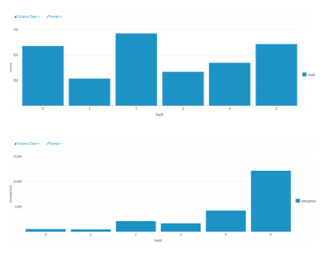
Data Exploration Overview
• item “2” is the most purchased, the item “1” is the least purchased
•item “5” made the most money, and the item “1” made the least money
Notes:
Assuming you have <2 minutes for this slide, what is the most important thing(s) to convey from your experience with exploring the data?

Slide 5
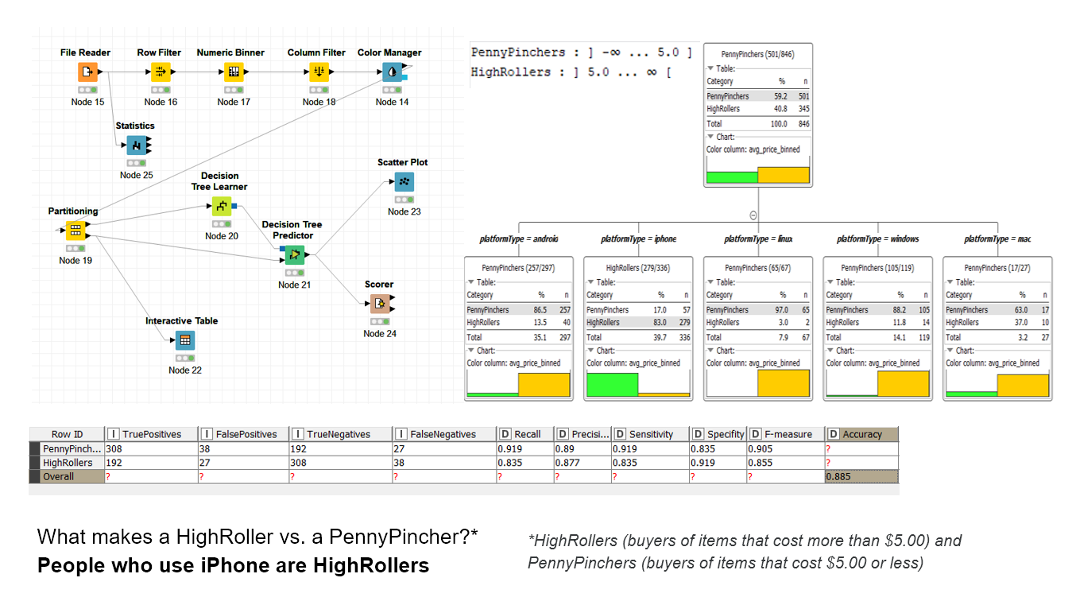
What have we learned from classification?
Notes:
Assume you have 2 minutes to present what you perceive to be the most important or remarkable points from your classification analysis.

Slide 6
Specific Recommendations
1. Show more ads to iphone users and increase ads price for the same platform device.
2. Offer temporary discounts to motivate Penny Pinchers to buy items that cost more than 5 dollars.

Slide 7
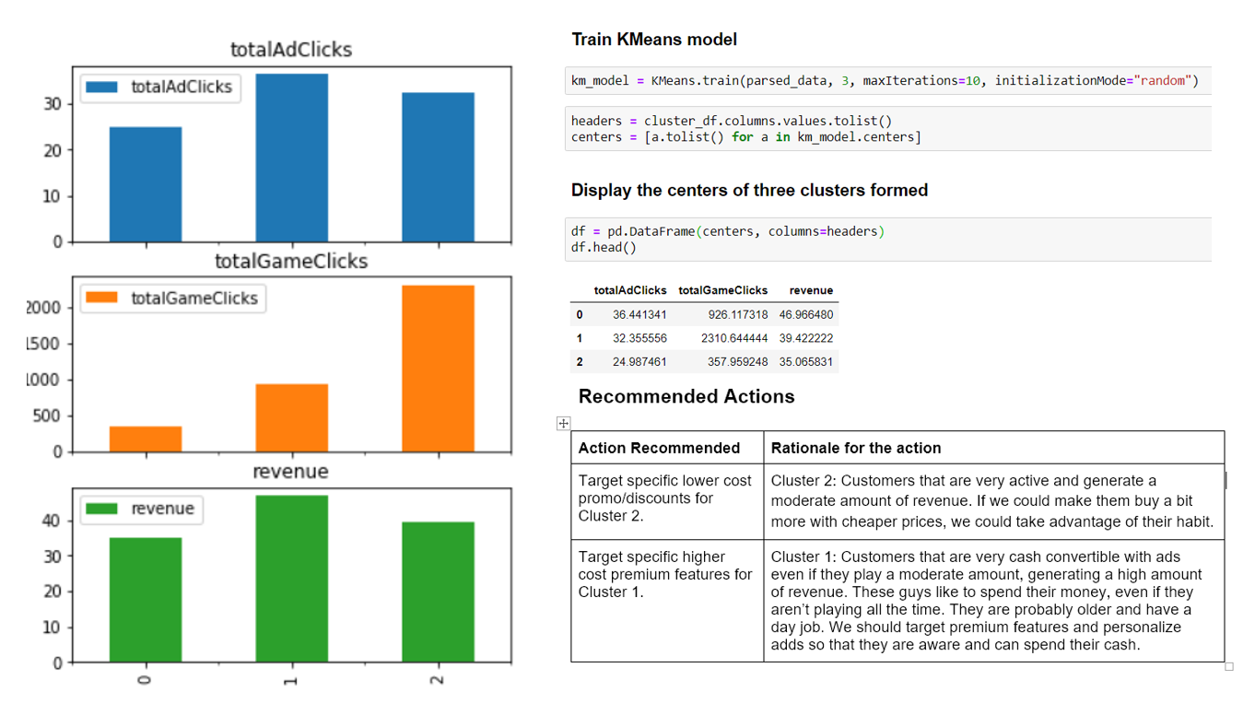
What have we learned from clustering?
Notes:
Assume you have 2 minutes to present what you perceive to be the most important or remarkable points from your classification analysis.

Slide 8
Specific Recommendations
Action Recommended | Rationale for the action
Make items promotions based on how much clicks they make. | Suppose a user is playing a session, if he/she reach 100 clicks in that session, he/she get a promotion on an item (only on that session and to use on that session). This incentivate the user to spend more time playing, to get more promotions.
Make items promotions based on how much sessions they start | Suppose the user start a session, and is his 1000 session, he/she can buy an item (only on that session and to use on that session) with less prices. This incentivate the users to come play more time so he/she can get more promotions.

Slide 9
What have we learned from chat graph analysis ?
Finding the longest conversation chain and its participants.
Analyzing the relationship between top 10 chattiest users and top 10 chattiest teams.
How Active Are Groups of Users?
Notes:
Assume you have 2 minutes to present what you perceive to be the most important or remarkable points from your graph analysis

Slide 10
Specific Recommendations
target most active users with more promotions/incentive.
subjects or topics users are enthusiastic about and we can therefore set business plan targeting on these subjects.

Slide 11
Final Insights
• Offer more expensive offers and other products to iPhone users.
• Target ads or even make pack of items to users based on their behavior
• Provide some fixed pay packages or promotion to users, especially to “low level spending user”
• Target influencers that will spread the word of our products
Notes:
From your own viewpoint, make one recommendation/action the Eglence should follow to improve their business. Be sure to explain your rationale.

